Slide 1
Inha University in Tashkent
Theme 4: Philosophical Thoughts in Temurids' Period

Slide 2
Outline:
Timurids Period and Its Cultural Legacy
The State of the Art of Logic
The Development of Astronomy and Natural Sciences
Scholars on Literature and Ethics

Slide 3
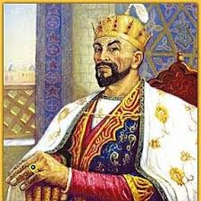
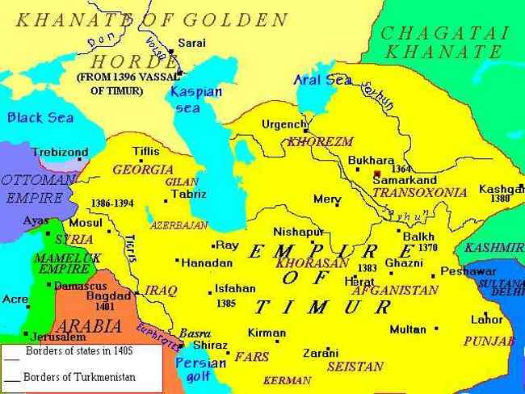
Characteristic feature of the Period
The Timurid Empire was founded by Amir Temur. He became the ruler of Central Asia in 1370.
During the reign of Timurids, Movarounnahr and Khurasan achieved significant progress in all aspects, especially in socio-economic and cultural life.
The Temurids' epoch characterized as the highest peak of the civilization and culture of the peoples of Central Asia, was a unique stage not only within the region, but also on a global scale.
The Timurid rulers sponsored the development of science and culture, and as a result, great scientists and eminent scholars of their time grew up from the region. They made outstanding contribution to world science, particularly to the development of philosophical thinking through their works and scientific heritage.
The scholars of the Timurid period carried out scientific study in various fields of science. In the 14th-15th centuries such areas of science as logic, natural sciences, especially astronomy, as well as philosophy and ethics were developed.

Slide 4
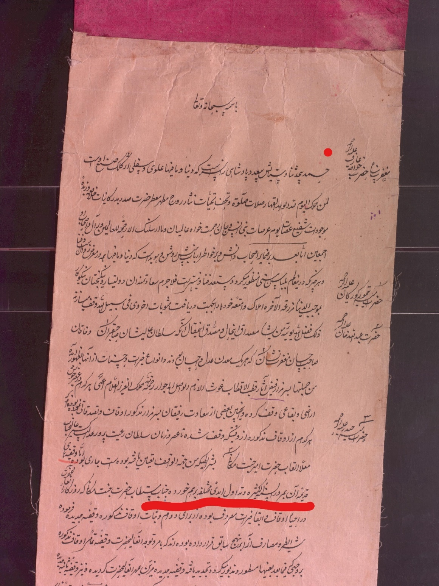
Amir Temur’s waqf document
Date: 19 century
Woqif/donator: Amir Temur
Type of property: Tremendous lands between two mountains
The object: Tomb of Kwoja Orif Revgari

Slide 5
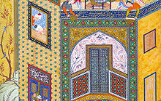
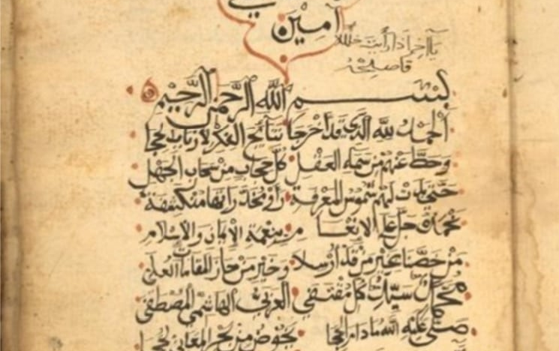
The State of Art of Logic
Sa'diddin Taftazoni (1322-1390) is one of the great representatives of logic. He was born in the village of Taftazon in the province of Nisa. From childhood he engaged in Arabic language, rhetoric and logic.
As a professor, he taught students at Turkestan, Herat, Jam, Gijduvon madrasahs. The fame of Taftazoni, his works spread to the Near and Middle East. At the invitation of Temur, the scholar came to Samarkand and lived there until the end of his life. Taftazoni is the author of more than 40 scientific works.
He explained his idea of cause and effect, freedom of thought, knowledge, consciousness, logic and its functions. For instance, he acknowledges the existence of cause and effect in nature. By focusing on the freedom of will, the good deeds derived from the essence of God.

Slide 6

The Process of Cognition
According to Taftazani, the process of cognition involves three stages:
1) the interaction between the sense organs and objects;
2) the acceptance of these factors by the human spirit;
3) mental knowledge.
Taftazani believed that mental or logical knowledge is much farther than the material basis, and it emerges at a higher level than emotional knowledge. Logic creates the basis for new knowledge. Imagination and approval are forms of logic.
The importance of Taftazoni's philosophy is that he developed the “Ilm al-Kalom” (Islamic scholastic theology) and applied logical principles into the subject and influenced on the foundation of the Ulughbek’s academic school.

Slide 7
Mir Sayyid Sharif Jurjoniy
One of the prominent philosophers of that period was Mir Sayyid Sharif Jurjoniy who was born near Astrobod city.
Jurjoniy travelled to Istanbul, Cairo, Herat, Shiraz in order to study the secrets of knowledge from scholars of these cities.
From 1387, he started to teach logic, philosophy, cosmology, Islamic jurisprudence and literature
Jurjoniy is the author of more than 50 works, many of which are devoted to key issues of logic, fiqh, philosophy and natural sciences. In particular, among his books are “Al-Ta’rifāt”, “Sughrā”, “Awsat dar mantiq”, “Risāla-i wujudiyya”
Moreover, he wrote commentaries on the works of Ibn Sinā, Chaghminiy and Nasriddin Tusi

Slide 8
Philosophical Thoughts of Jurjoniy
Jurjoniy analyzes issues such as existence, matter and its forms, physical and spiritual attitudes, logical thinking, interrelationship between language and thinking, universe, humanity, intellect and cognition.
Jurjoniy argued that, as with Taftazoni, everything and objects are in proportion to each other.
Simple things are based on four elements:
Water
Fire
Air
Soil
Metals, plants and wildlife come from the combination of these four elements.

Slide 9
Interaction between Logic and Philosophy
Jurjoniy analyzes logic and philosophy interactively.
The conclusion is divided into three types:
Syllogism (private conclusion is derived from the general)
Induction (method of reasoning from private to general)
Analogy (similarity of objects and cognition by comparison)
Syllogism is the basic means of creating theoretical knowledge. According to Jurjoniy, the knowledge acquired in the inductive way is not always true, because human experience is not always perfect
Jurjoniy also commented on the logic of science. He does not distinguish logic from philosophy, but at the same time proves that it (logic) is closely related to law and language. Therefore, from the 14th-15th centuries, the teaching of logic was conducted in connection with the subjects of law and linguistics in madrassas

Slide 10
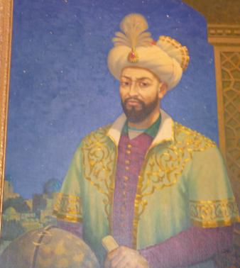
Mirzo Ulughbek
The great scientist and statesman, Muhammad Taragay Ulugbek (1394-1449), who made a great contribution to the development of world science, was a leading figure on mathematics and astronomy.
He was the grandson of Amir Temur and son of Shohruh Mirzo
Ulugbek was interested in sciences in his youth
Qozizoda Rumi and Ghiyosiddin Jamshid were instructors of Ulughbek
Though he was a statesman, he spent a lot of effort in the development of culture and science, conducted research in mathematics, astronomy, geometry, history, chemistry and other fields.
Ulughbek was influenced by philosophical ideas of Aristotle, Ptolemy, Muhammad Khorezmi, al-Farghani, Farobi, Ibn Sino, Beruni and others.

Slide 11
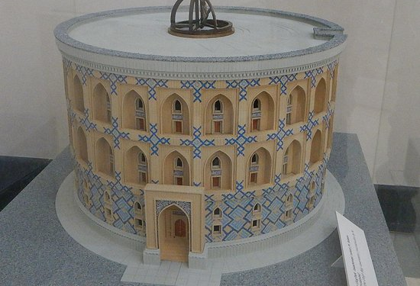
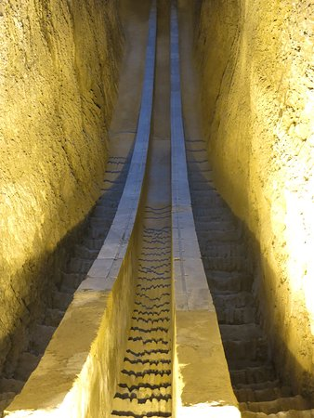
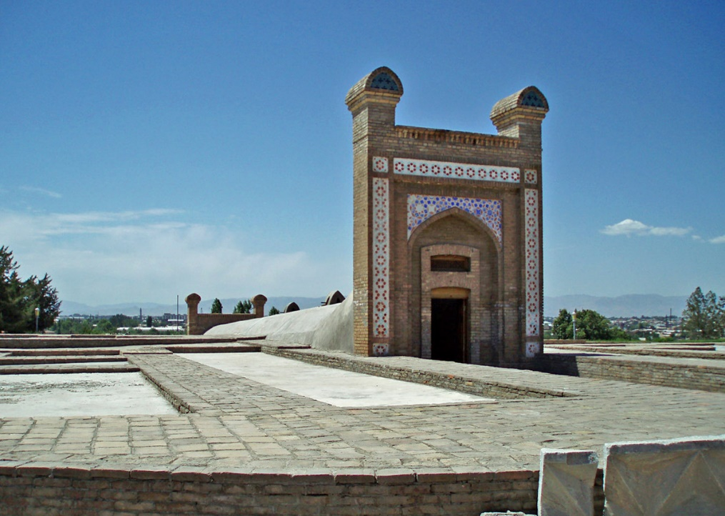
One of Ulugbek's great works is that he built an observatory in Samarkand. The construction of this observatory began in 1424 and was completed in 1429.

Slide 12
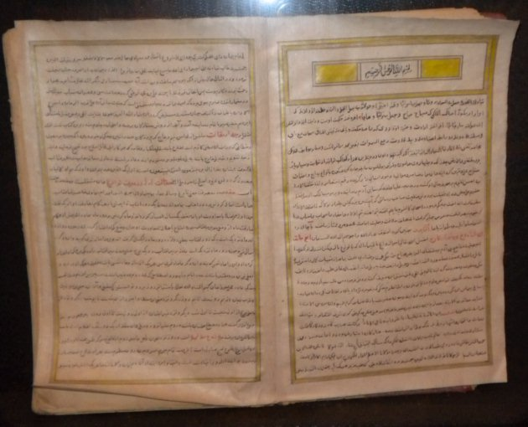
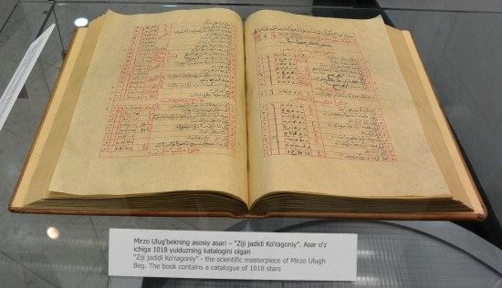
The most important work of Ulugbek is named "Zij-i Jadid-i Kuragāniy"
"Zij-i Jaded-i Kuragāniy"consists of two chapters, preface, and the location and condition of 1018 stars
In addition, Ulugbek wrote on mathematics, and history. Ulugbek knew perfectly well the theory of logic, fiction, music and literature
Ulugbek uses different methods for studying the planets, such as observation, experimentation, proof, comparison, induction, deduction and others
It should be noted that Ulugbek accurately calculates the motion of the sun and the moon, their detention and time, even though the observation and measurement devices were not perfect. He gathered talented scientists around himself and invited genius scholars from other countries
Ulughbek's ideas about astronomy from the 16th century were developed by Copernicus, Galileo and others in Europe

Slide 13
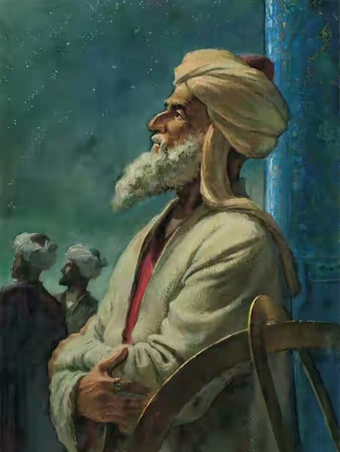
Alouddin Ali ibn Muhammad Qushchi (1403-1474) was a student of Ulugbek who was famous for his name Ali Qushchi. He conducted his scientific works in the field of astronomy and mathematics.
He is the author of more than 23 works such as “The Book on Arithmetic”, “The Book on Logic”, “The Book on Astronomy”.
He scientifically justified the fundamentals of Moon and Solar Eclipse in his “The Book on Astronomy”.
The scientist studied the secrets of nature and its principles, suggesting that the motion of objects move from simple to complex.

Slide 14
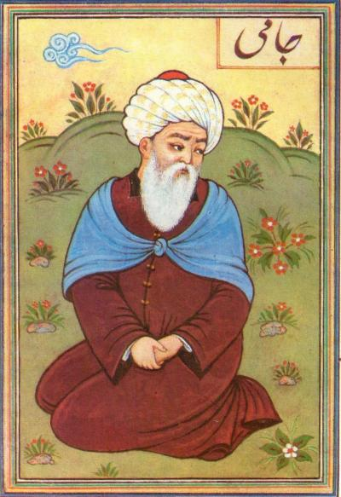
The Cultural Development in Herat
Abdurahman Jomi (1414-1492) was the great poet and thinker of the medieval classical literature
The works of Jomi - “Nafohat al-Uns”, “Hujjat al-Asror”, “Naqsh-i Fusus”, “Bahoriston” etc.
The greatest work of Jomiy is "Haft Avrang", which includes eposes such as “Tuhfat al-Ahror”, “Suhbat al-Abror”, "Yusuf and Zulayha", “Suhbat al-Asror”, "Layli and Majnun", "Salamon and Absol", "Hiradnama-i Iskandari"

Slide 15
Philosophical Thoughts of Abdurrahmon Jomi
Like all Muslim intellectuals, Jomiy believes that God is eternal, absolute, and the cause of everything in the world, God is the creator of all things
Jomi's philosophical views are closely linked to his humanistic ideas. Many works of Jomi describe the ideas of human being, justice, love, goodness
Jomi followed Naqshbandiya Sufi order and developed its theoretical and practical aspects. According to him, Sufi is to be honest and pure, and should occupy a profession, to be reasonable and noble, to overcome his desires

Slide 16
He describes God as a "violent lover" and says that primary purpose of the human being is to achieve the meeting with God
In his socio-political and ethical views, he used to think of a virtuous society, and supported the state system that based on equality, liberty, conscience.
Jomi’s philosophy has been influenced by the teachings of Ibn al-Arabi who was great Sufi mystic, poet and philosopher of 12-13 centuries

Slide 17

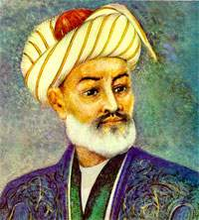
Alisher Navoiy
Alisher Navoiy is the great poet and statesman, the founder of Uzbek literature.
He belonged to the Timurid family and his father, Giyosiddin, was from the Barlas kin who had gone from Shahrisabz to Kabul.
Navoi served in various positions in the Court of Husayn Boyqaro, and in 1472 became his Minister.
The poet has done a lot for the prosperity and well-being of the country. He built schools, madrasas, mosques, bridges, hospitals, helped the needy and the poor, sponsored scholars and poets.

Slide 18
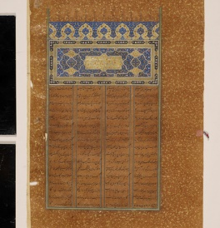
Literary Legacy
Navoi’s scientific legacy is great, his works are devoted to various aspects of science. "Hamsa" that included five eposes – "Hayratul abror", "Farhod and Shirin", "Leyli and Majnun", "Sabai Sayyor", "Saddi Iskandari" and "Lison Ut-Tayr", "Majolis un-nafois", "Mahbubul Qulub", "Mezon ul-avzon", "Muhokamatul-lug'atayn" and others.
Navoi has created a poetic collection called "Khazoyinul maoniy" ("The Treasure of Meanings"), which consisted of about 45,000 misras (hemistich) of gazals, ruboiys, qit’as and fards.

Slide 19
If one element, that is, dot falls it will lead to blind in eye!
کوز کور

Slide 20
Contribution to Philosophy
Navoi believed that Chagatai language was superior to Persian in terms of literary purposes, richness and precision. He defended his belief in the work titled “Muhokama al-Lughatayn” (The Trial of the Two Languages).
The work of Navoi is rich in philosophical thoughts and he discusses the relationship between society and human being, the perfect person and virtuous society.
An important feature of the sociological and philosophical views of the poet is that philosophical thoughts are interpreted metaphorically and symbolically.
Navoi sees God in the unity of nature and human being. The nature of the human is the dearest of all creatures. Human being is superior to other creatures in terms of intellect and cognizance. Humans perceive the outside of things and objects by using their sense organs.
He thinks that everything is in constant development and in the interconnectedness, and nature is constantly developing and interconnected. Love is the mean of moral refinement of human being, the understanding of the truth, the approach of God.

Slide 21
Voiz Koshifiy
Mavlono Husayn Voiz Koshifiy (1440-1505), one of the prominent thinkers of that period, contributed to the development of philosophy of ethics in Central Asia and Khurasan.
Koshifiy was born in Sabzavar, later moved to Herat at the invitation of Abdurrahman Jomi. He spent the rest of his life in Herat and died there.
He became as a great scientist and a teacher and dedicated his entire life to the development of science and literature. He had friendly relations with Navoi and Jomi.

Slide 22
Voiz Koshifiy conducted the research in various fields of science
He is the author of several works such as "Ahloq-i Muhsiniy", "Futuvvatnoma-i Sultan ", "Risolai Khatamiya" and others.
In these works, the thinker delivers valuable insights into the wise management of the state, embodying the principles of good manners, the acquisition of science and profession
He leads discussion on the issue of justice, and interprets it as an expression of the sense of equality among the humans

Slide 23
Thank you for your attention!

